Slide 1
Impulse

Slide 2
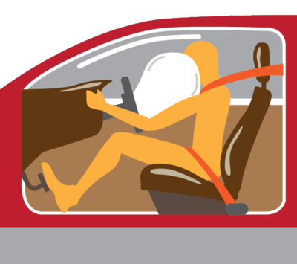
In this Smart Lesson you will learn to:
Define the term impulse.
Solve problems involving momentum and impulse.
Determine and interpret the area under a force-time graph.

Slide 3

Understanding impulse in physics has many everyday applications.
Have you ever wondered how the air-bags in cars work? Or how to play the perfect game of snooker? Or how to hit a cricket ball for 6?
An understanding of impulse will help you learn how these all work.

Slide 4
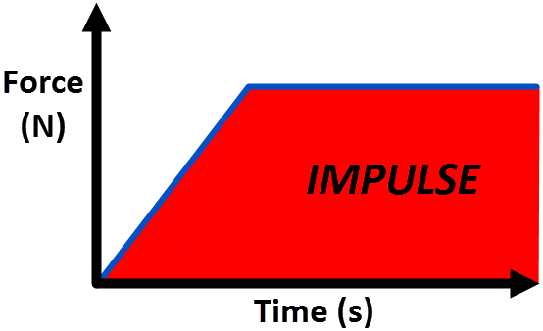
Impulse is defined as the change in momentum of an object.
It equals the product of a force and the time interval over which the force acts. If you graph the force applied over time, the area under the graph is the impulse.

Slide 5
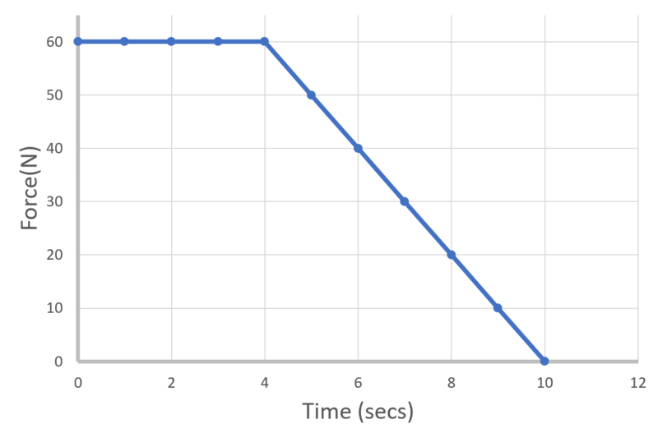
For example, calculate the impulse of an object from the following force-time graph.
Remember, the impulse is the area under the graph.

Slide 6
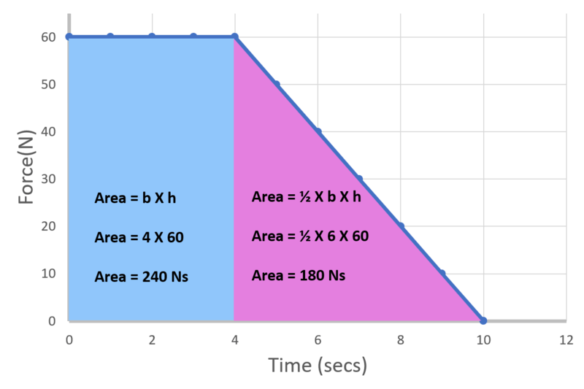
First divide the area under the graph into simple shapes, then work out the area.
Impulse = area under graph
Impulse = 240 + 180
Impulse = 420 Ns

Slide 7
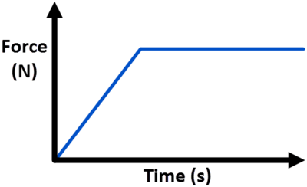
An impulse is a force applied over time.
It acts in the same direction as the force, so is a vector.
I=F×Δt
The unit of impulse is the newton-second (Ns).

Slide 8
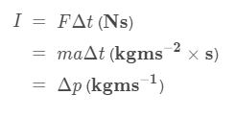
Impulse acting on a mass is equal to the change in momentum of the mass.
I=Δp
We can double check this idea by looking at the units of impulse and momentum.

Slide 9
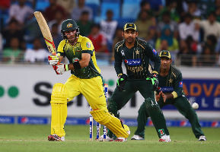
So how does this relate back to collisions such as car crashes and hitting a cricket ball?
You know that impulse = force × time.
If a force is applied for a longer time, it will have a larger impulse and larger change in momentum.
For example, when you swing for a cricket ball, don't stop when you hit it, but follow through. This keeps the bat in contact with the ball for a longer time, creating more impulse, so you can hit that ball for 6!

Slide 10
By understanding collisions in terms of impulse and momentum, car manufacturers have been able to design air-bags to minimise the damage caused during a crash.

Slide 11

When a car crashes, the people in the car still have forward momentum and are thrown forward.
By calculating the momentum, car designers can work out how to cushion the impact with a rapidly inflating airbag, which helps absorb the energy of the forward motion and reduce injuries. As the airbag slows the impact over a longer period of time, the force is reduced.

